Slide 1

Surgical Video Analysis
AI ML Project Elective Term-II 2022-23
Week IV Mar31-Apr7

Slide 2
Task Assigned
Task: Surgical Tool Detection
Dataset: m2cai-16 tool localizations

Slide 3
This Week
YOLO v7 – Trainable bag-of-freebies

Slide 4
Trainable bag-of-freebies
Optimization modules and models that strengthen the training cost to improve the accuracy without affecting the inference cost

Slide 5
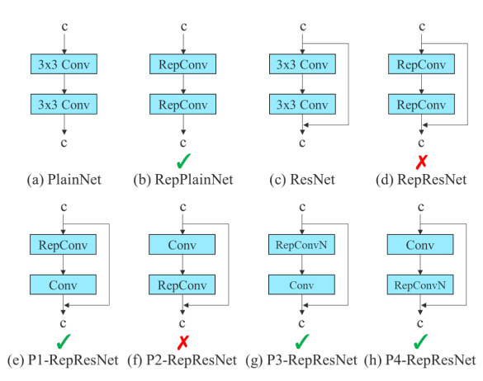
Planned Re-parameterized Convolution
RepConv – a technique to improve the efficiency of a model
Combines 3x3 conv, 1x1 conv and identity connection in one layer
Works well for VGG, but significant downfall in accuracy when applied to ResNet or DenseNet
On analysis – identity connection destroys residual in ResNet and concatenation in DenseNet
Remedy – when a conv layer with residual/concatenation connection is replaced with re-parameterized layer, identity connection must be avoided

Slide 6
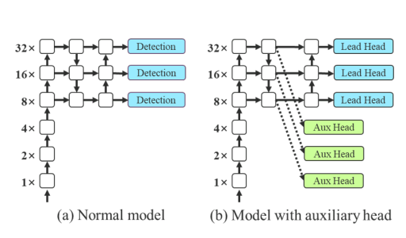
Coarse for auxiliary and fine for lead loss
Deep Supervision
add extra auxiliary heads in the middle layer of the networks
add shallow network weights with assistant loss as the guide
Optimizes the model

Slide 7
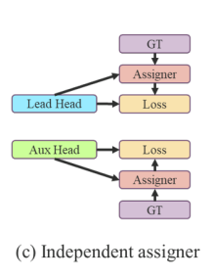
Coarse for auxiliary and fine for lead loss
Traditionally., label assignment for deep supervision is done by separating the predictions of lead and auxiliary head and assigning the labels using the ground truth
Here, we have new methods
Lead head guided label assigner
Coarse-to-fine lead head guided label assigner

Slide 8
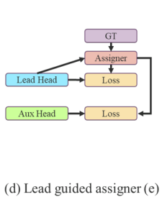
Lead head guided label assigner
Calculated based on prediction of the lead head and the ground truth
From this soft label is generated through optimization process
Along with lead head, these soft labels are used as the target training models for the auxiliary head too.
Because lead head has a relatively strong learning capability. Thus, this can represent the correlation effectively.

Slide 9
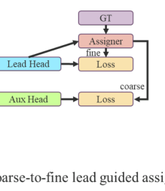
Coarse-to-fine lead head guided label assigner
Like previous assigner
Instead, generates two sets of soft labels – coarse label, fine label
Fine-label : Same as the one generated by lead head guided label designer
Coarse-label: Relaxing the constraints on positive targeting – allowing more grids to be taken as positive label
Auxiliary head can't learn as good as lead head, so we focus on optimizing the recall of auxiliary head to avoid the info it needs to learn
To have these grids less impact, we put restrictions in the decoder, so that the extra coarse positive grids cannot produce soft label perfectly

Slide 10
Loss Function
There is no valid resource (as far as I know) that guarantees this is the YOLOv7 loss function
However, the predictions that needs to be sent into the loss function were explained

Slide 11
Next week..
YOLOv7 (If anything is left)
Start the implementation of this model on the m2cai-16 tool locations dataset

Slide 12


